Slide 1


Slide 2

CONTENTS
BUSINESS OBJECTIVE
BUSINESS CONSTRAINTS
PROJECT ARCHITECTURE
EXPLORATORY DATA ANALYSIS
DATA PREPROCESSING
FEATURE ENGINEERING
PIPELINE
PROJECT CHALLENGES

Slide 3
BUSINESS PROBLEM
IN THE COMPETITIVE TENDER LANDSCAPE, SECURING CONTRACTS DEPENDS ON OFFERING THE RIGHT PRICE. HOWEVER, WITHOUT INSIGHT INTO COMPETITORS STRATEGIES, OUR CLIENT FACES THE CHALLENGE OF EITHER LOSING TENDERS DUE TO HIGH PRICING OR RISKING PROFIT MARGINS BY UNDERPRICING.

Slide 4
OBJECTIVE:
TO INCREASE THE SUCCESS RATE OF TENDER
CONTRACTS.
CONSTRAINT:
TO MINIMIZE POTENTIAL LOSSES IN PROFIT MARGINS BY DEVELOPING A DATA-DRIVEN PRICING STRATEGY

Slide 5
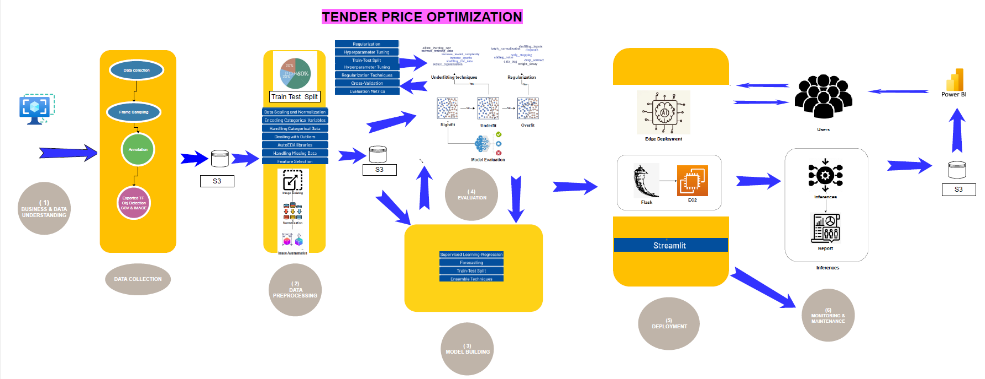
PROJECT ARCHITECTURE

Slide 6
EDA

Slide 7
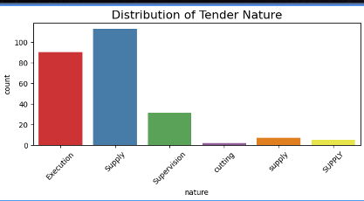
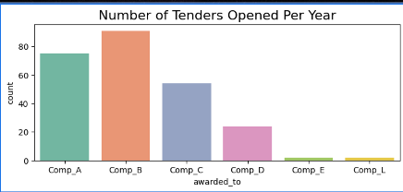
"SUPPLY" TENDERS ARE THE MOST FREQUENT
THE DATASET HAS DIFFERENT VARIATIONS: "SUPPLY", "SUPPLY", AND "SUPPLY"
COMPANY B DOMINATES WITH 80+ TENDERS.

Slide 8
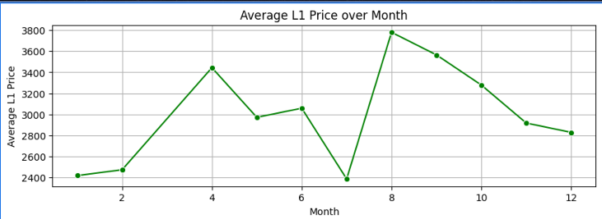
TREND: THE PRICE FLUCTUATES SIGNIFICANTLY OVER 12 MONTHS .
HIGH POINTS: PEAKS IN MONTH 2, 4, 8, AND 10
LOW POINTS: DIPS IN MONTH 1, 7, AND 11

Slide 9
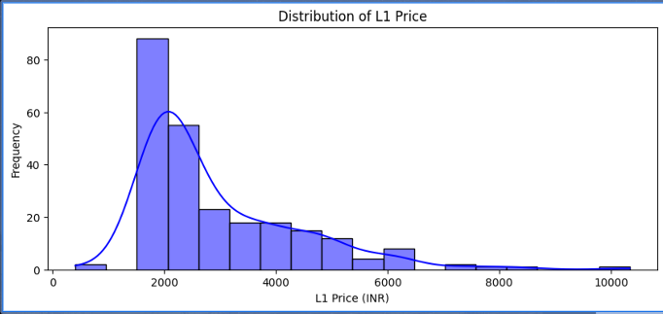
TREND: RIGHT-SKEWED DISTRIBUTION , MORE LOW-PRICED L1S ,
FEWER HIGH-PRICED ONES
HIGH: MOST L1S ARE BETWEEN 1000-2000 INR .

Slide 10
STATISTICAL INSIGHTS
CORRELATIONS :
BASIC AND L1_PRICE ARE STRONGLY POSITIVELY CORRELATED (R = 1.00)
TENDER_NO AND L1_PRICE HAVE A SLIGHTLY NEGATIVE CORRELATION (-0.20)
SKEWNESS :
QTY IS HIGHLY RIGHT-SKEWED (SKEW = 10.28)
COMP_A, COMP_B, AND COMP_C SHOW MODERATE RIGHT-SKEW

Slide 11
KURTOSIS :
TENDER_NO PLATYKURTIC WITH LIGHT TAILS (KURTOSIS = -1.28) .
QTY HAS EXTREMELY HEAVY TAILS (KURTOSIS = 110.90) .
OUTLIERS :
L1 PRICE AND BASIC HAVE HIGH-VALUE OUTLIERS (> 6000 INR) .
TENDER NUMBERS ARE STABLE WITH NO DETECTED OUTLIERS .

Slide 12
BUSINESS INSIGHTS
COMPANY B LEADS IN TENDERS AWARDED , ESPECIALLY IN RECENT YEARS .
COMPANY A & C FOLLOW CLOSELY, EXCELLING IN DIFFERENT PERIODS
TENDER NATURE
SUPPLY TENDERS DOMINATE, FOLLOWED BY EXECUTION AND SUPERVISION .
CUTTING IS LESS COMMON .
NAME ERROR WITH SUPPLY

Slide 13
VARIABLE
DICTICTINARY

Slide 14
VARIABLE | DESCRIPTION
TENDER NO | UNIQUE IDENTIFIER FOR EACH TENDER.
NAME OF RAILWAY | NAME OF THE CITY AND RAILWAY DIVISION.
DATE OF OPENING | DATE THE TENDER BIDS WERE OPENED.
NATURE | TYPE OF WORK INVOLVED IN THE TENDER (E.G., SUPPLY, EXECUTION, SUPERVISION, CUTTING).
AWARDED TO | COMPANY OR CONTRACTOR AWARDED THE TENDER.
L1 PRICE | PRICE QUOTED BY THE LOWEST BIDDER (L1).
BASIC | BASE PRICE OF MATERIALS OR WORK BEFORE ADJUSTMENTS.
52 KG | WEIGHT OF THE 52 KG RAIL PER METER OR PER UNIT IN KILOGRAMS.
60 KG | WEIGHT OF THE 60 KG RAIL PER METER OR PER UNIT IN KILOGRAMS.
R260 | R260 STEEL IS A HIGH-QUALITY STEEL USED FOR RAIL MANUFACTURING, KNOWN FOR ITS STRENGTH AND DURABILITY.
R260 CMB | SPECIFIC VARIANT OR UPGRADED VERSION OF R260 STEEL, POSSIBLY INDICATING A DIFFERENT TREATMENT OR COATING.
60/52 CMB | COMBINATION OF 60 KG AND 52 KG RAILS, POSSIBLY WITH A SPECIFIC CMB TREATMENT OR FEATURE.
HH 1080 | HEAD-HARDENED STEEL OF GRADE 1080, DESIGNED FOR HIGH DURABILITY, ESPECIALLY IN HIGH-SPEED OR HEAVY-DUTY RAIL SYSTEMS.

Slide 15
DATA PREPROCESSING
FILL MISSING VALUES IN THE FIRST TWO ROWS .
MERGE HEADERS AND MAKE THEM UNIQUE.
DROP UNNECESSARY COLUMNS LIKE "TENDER NO." AND "TIME" .
RENAME COLUMNS FOR CLARITY.
REMOVE EMPTY ROWS AND ROWS WITH MISSING TENDER NUMBERS.
CONVERT COLUMNS TO APPROPRIATE DATA TYPES (E.G., INT, FLOAT, DATETIME) .
FILL MISSING VALUES IN SPECIFIC COLUMNS .

Slide 16
FEATURE
ENGINEERING

Slide 17
FEATURE ENGINEERING :
CREATE A NEW 'CATEGORY' COLUMN BASED ON THE MAX VALUE ACROSS CERTAIN COLUMNS .
ADD TOTAL COLUMNS FOR COMPANIES (E.G., COMP_A, COMP_B) .
REMOVE OLD COLUMNS AFTER CREATING TOTALS .
MAP RAILWAY NAMES TO SPECIFIC LOCATIONS AND ZONES .
ADD COLUMNS FOR RAILWAY_LOCATION AND ZONE.
MAP RAILWAY DIVISIONS (E.G., BHOPAL, NAGPUR) .

Slide 18
PIPE LINE

Slide 19
PIPE LINE
1. AUTOMATES THE WORKFLOW
ML INVOLVES MULTIPLE STEPS: DATA PREPROCESSING, FEATURE ENGINEERING, MODEL TRAINING, AND EVALUATION. A PIPELINE AUTOMATES THESE STEPS, ENSURING CONSISTENCY AND SAVING TIME.
2. MODULAR DESIGN
PIPELINES BREAK DOWN COMPLEX ML WORKFLOWS INTO SMALLER, MANAGEABLE COMPONENTS (E.G., SCALING, ENCODING, MODELING). EACH MODULE IS REUSABLE AND CAN BE TESTED INDEPENDENTLY.

Slide 20
3. ENABLES EXPERIMENTATION
PIPELINES MAKE IT EASIER TO TEST DIFFERENT PREPROCESSING TECHNIQUES OR MODELS BY SWAPPING COMPONENTS WITHOUT BREAKING THE WORKFLOW.
4. REPRODUCIBILITY
A PIPELINE PROVIDES A DOCUMENTED AND EXECUTABLE SEQUENCE OF STEPS, ENSURING THE SAME PROCESS CAN BE REPLICATED ACROSS TEAMS OR PROJECTS.

Slide 21
5. SCALABLE DEPLOYMENT
FOR PRODUCTION SYSTEMS, PIPELINES ALLOW SEAMLESS DEPLOYMENT OF THE FULL ML PROCESS, FROM DATA INGESTION TO INFERENCE.
6. OPTIMIZES HYPERPARAMETER TUNING
MANY FRAMEWORKS ALLOW INTEGRATION OF HYPERPARAMETER TUNING INTO PIPELINES, ENSURING OPTIMIZATION ACROSS PREPROCESSING AND MODEL TRAINING SIMULTANEOUSLY.

Slide 22
PROJECT
CHALLENGES

Slide 23
PROJECT CHALLENGES
THE DATA WAS UNSTRUCTURED AND NOT PROPERLY ORGANIZED.
THE COLUMNS FOR QUALITY AND COMP_A TO COMP_L CONTAINED DOUBLE HEADERS, MAKING IT A CHALLENGE TO CONVERT THEM INTO SINGLE HEADERS AND CORRECTLY MAP THE VALUES.
THE DATASET INITIALLY CONTAINED OVER A MILLION ROWS, BUT AFTER DATA CLEANING AND REMOVING NULL VALUES, IT WAS REDUCED TO JUST 250 ROWS.
WITH SUCH A SMALL DATASET OF ONLY 250 DATA POINTS, IT BECAME DIFFICULT TO EFFECTIVELY TRAIN THE MODEL.
THE DATASET CONTAINED SIGNIFICANT QUALITY ISSUES, INCLUDING INCOMPLETE AND INCONSISTENT DATA.

Slide 24

IF YOU HAVE ANY QUESTIONS OR NEED FURTHER CLARIFICATION, FEEL FREE TO ASK.
PRESENTED BY:
MANDEEP SINGH THAKUR

